Slide 1
Exciting and Effective Community – Higher Education Collaborations
Marshall Curry and Joel Rogers
Notes:
Thanks Debra and Daita for that kind introduction.
------->

Slide 2
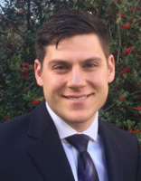
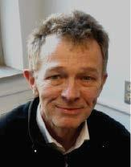
EPIC-N Speakers
Marshall Curry
Program Associate
mcurry@epicn.org
608-709-8644
@marshall_curry
Joel Rogers
Chair, Treasurer/Secretary
jrogers@epicn.org
608.890.2543
Notes:
….My name is Marshall and I am the Program Associate at EPIC-N. I am joined today by Joel Rogers the Chair and treasurer/secretary of EPIC-N and he also directs the UWMadison EPIC program called UniverCity Year . He is on the line and will be answering questions during our Q&A at the end of the webinar.
I am giving you my contact info right now because I really want to support you and answer your questions about community/university partnerships so write this down! Both of us are happy to take calls or emails to dive deeper with you after the call
For the past 7+ years I’ve studied, participated in, and worked to create effective university and community partnerships. I benefited as a participant and practitioner from different kinds of community engagement. The EPIC Model is one of them, and in my experience, it is the most efficient at unlocking a much larger impact for all involved. Which is why I am excited to share about it with you today.
My job at EPIC-N….

Slide 3
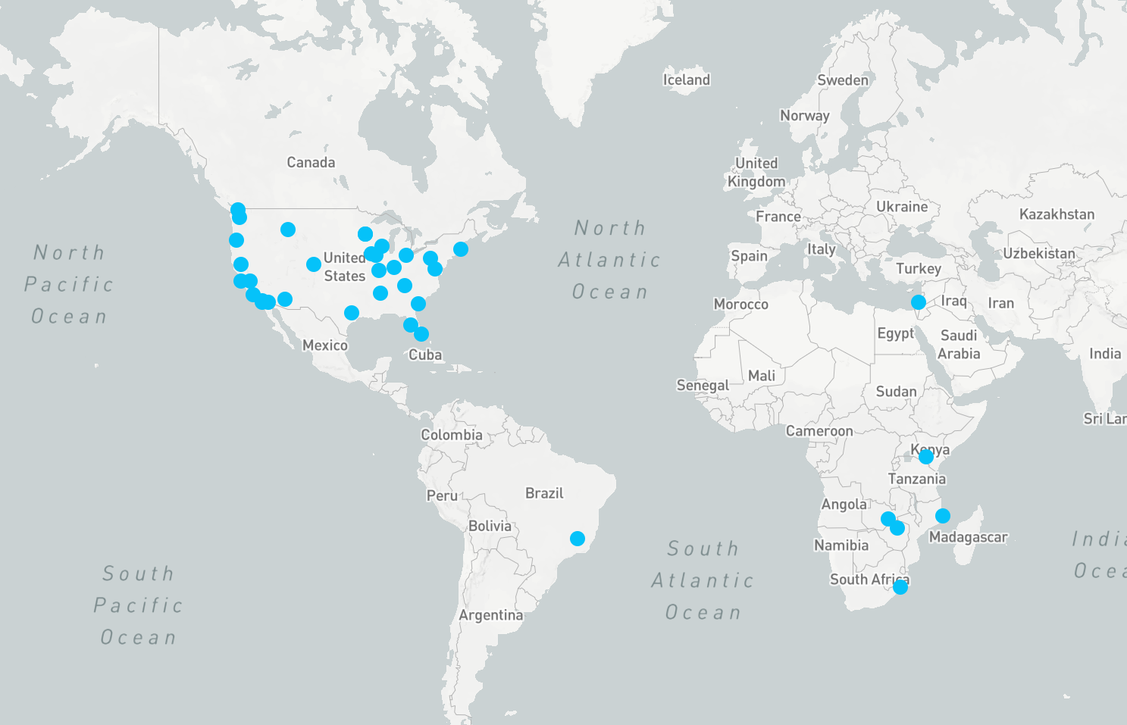
Who’s in the Network
www.epicn.org/whos-in-the-network
Notes:
….is to act as a switchboard, thought leader, and cheerleader for with the all of the institutions of higher education in our network and even those just considering joining
You can learn more about each of the programs on our website at the link on this slide.
Many of them...

Slide 4






































Arizona State University
Augustana
College
Boston University
Bowling Green
State University
CSU
Chico
CSU
Channel Islands
CSU
Fresno
CSU
Monterey Bay
CSU
San Marcos
Florida Atlantic
University
Gonzaga
University
Montana State
University
Indiana
University
Penn State
University
Southern Illinois
University, Edwardsville
San Diego
State University
Texas A&M
University
The University
of Iowa
The University
of Mississippi
University of
Colorado Denver
University of
Connecticut
University of
Maryland
University of
Minnesota
University of
Oregon
University
of St. Thomas
University of South Carolina Beaufort
University of South Florida
University of Tennessee Knoxville
University of
Washington
University of
Wisconsin-Madison
Utah State
University
Western Washington
University
Technion - Israel Institute of Technology
Universidad Autónoma de Baja California
Universidade Federal de Minas Gerais
University of
Zambia
University of
Nairobi
University of
Kwazulu Natal
Notes:
...act as peer-mentors, engaging in Community of Practice calls, regularly calling one another, etc. For example one of our program directors from Texas A&M joined the EPIC Africa monthly call by request last week to discuss how their program helped with resilience after Hurricane Harvey hit their community partner
Here’s one example of what one of these programs did during just one of year with one of their community partners...

Slide 5
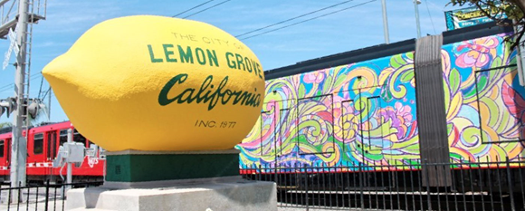
Five comprehensive development plans provide service opportunities in the midst of budgetary woes
Partnership with Sage at SDSU put Lemon Grove on a path for growth
Community:
Lemon Grove, California, US
Community Size:
27,108
University:
San Diego State University
Program:
The Sage Project
Academic Year:
2016–2017
Notes:
The Sage Project (the EPIC-N Program at San Diego State University) made five comprehensive development plans for the City of Lemon Grove during the 2016-2017 school year.
At the bottom you can see the university inputs unlocked by the EPIC Model for the community’s benefit.
In return….

Slide 6
Five comprehensive development plans provide service opportunities in the midst of budgetary woes
Partnership with Sage at SDSU put Lemon Grove on a path for growth
Community:
Lemon Grove, California, US
Community Size:
27,108
University:
San Diego State University
Program:
The Sage Project
Academic Year:
2016–2017
“…a remarkable 800 percent return on the initial investment…”
– Mike James, Assistant City Manager and Director of Public Works, City of Lemon Grove
Notes:
…..Mike James, the partner lead, and assistant city manager described the community’s ROI as 800% on their initial investment of $150,000.

Slide 7
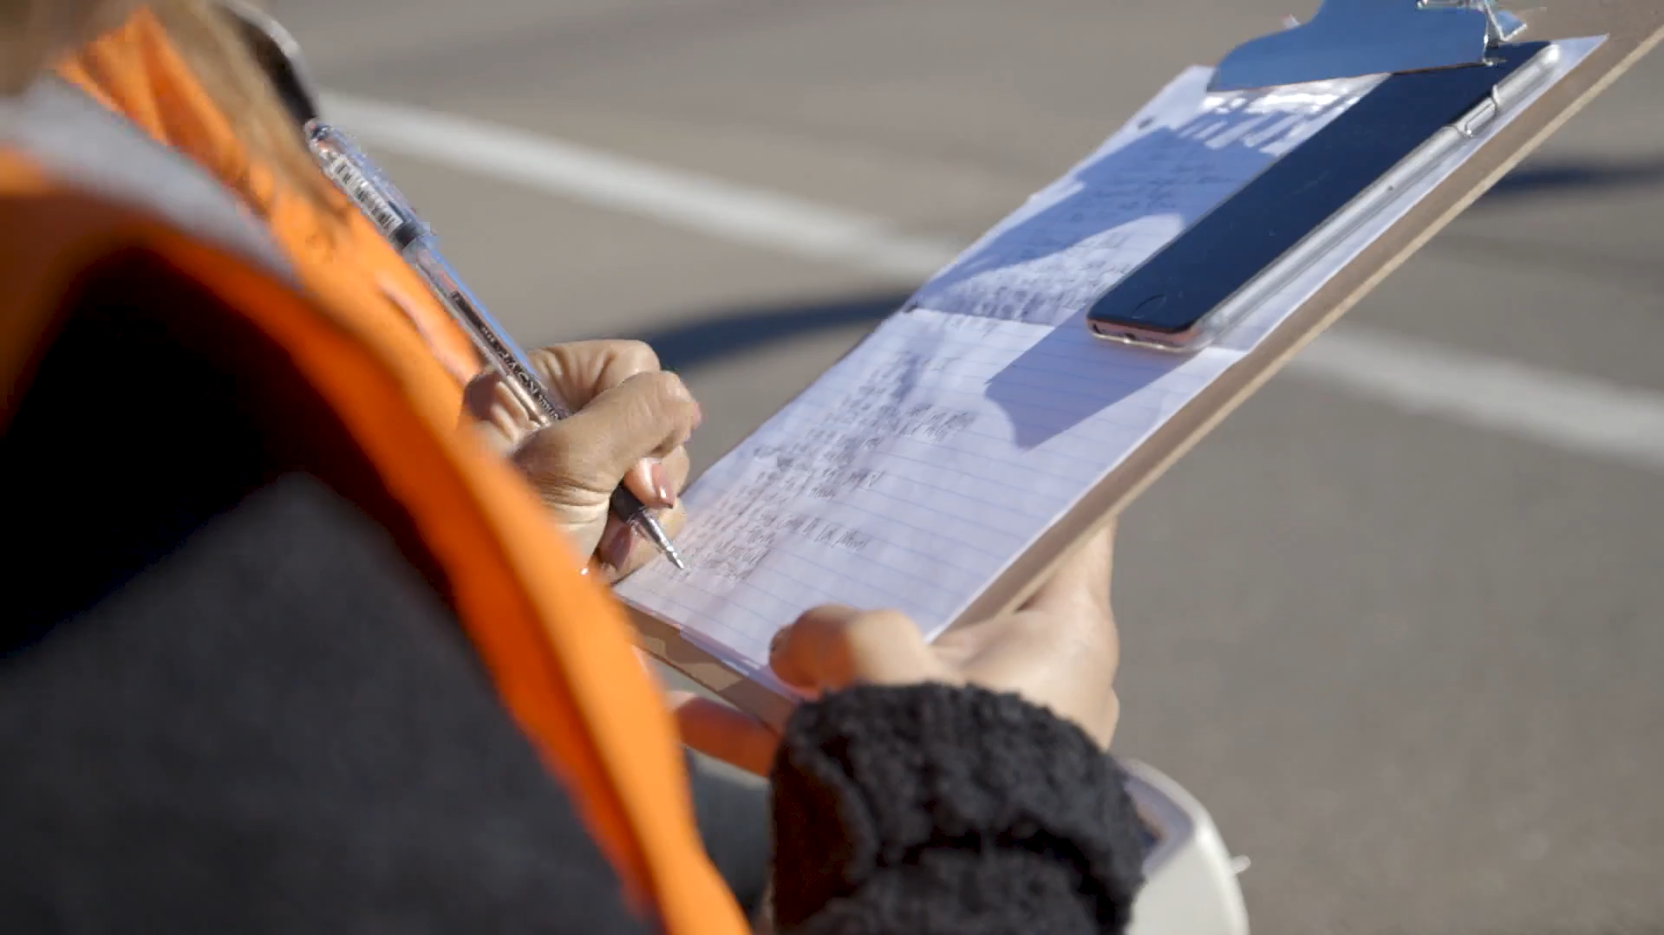
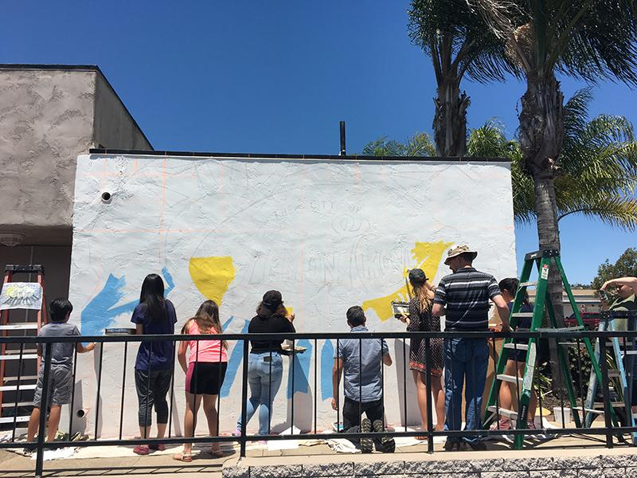
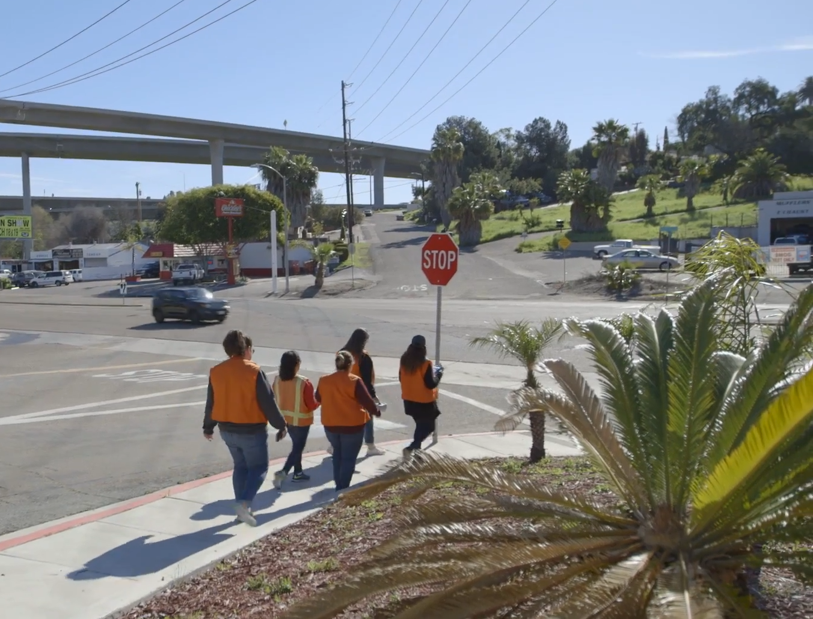
Student Work in Lemon Grove, CA
Notes:
Here are some pictures of what student work looked like during the project….

Slide 8
Sage Project: Lemon Grove deliverables
An urban agriculture analysis showing feasibility in creating a healthier and more secure community for the city.
Expanding GIS mapping from a dated inventory of existing street signs.
The revitalization of two downtown locations through a development plan.
Reimagined ideas to solve the city’s growing homelessness problem.
New community gardens from plans created by Sage students.
Greater social media interaction due to a development plan by students to inform and engage residents about Lemon Grove.
Two brand-new murals and designs for welcome signs developed by students to brighten downtown and points of entry
First city in North America to work with a United Nations toolkit to address climate change. (Press Links)
mcurry@epicn.org
608-709-8644
Notes:
…..During this one school year, SAGE coordinated those 30 EXISTING courses to provide 7 projects identified by Lemon Grove. These are brief descriptions of the projects.
They did an Urban Ag Analysis,
a GIS mapping project,
Drafted downtown revitalization plans
Reimagined ideas for supporting a growing population of people currently homeless
Designed some new community gardens (now actually built)
Created a social media campaign
Designed and Installed two new murals to brighten downtown you can see more of these murals on our website
And my personal favorite. Students and faculty helped the City of Lemon Grove became the first community in north america to create a Climate Action Plan They helped the city use a UN Toolkit with the goal of meeting the new CA requirment for all cities to drop carbon emissions by 15% by 2020. Lemon Grove shares their were not going to have the staff to meet this goal. But with the Sage Project….they are well on their way and now are a leader for the continent.

Slide 9
Examples of EPIC Community Partnerships
Use this link to access five print versions of the EPIC Community Partnership Case Stories: https://www.epicn.org/resources/community-partnership-case-stories/
Use this link to view the EPIC Community Partnership Case Stories online: https://www.epicn.org/case-stories/
mcurry@epicn.org
608-709-8644
Notes:
To learn more about partnerships in other states there are four other stories like the one from The Sage Project on our website for you to view. You can use these links to find them.

Slide 10
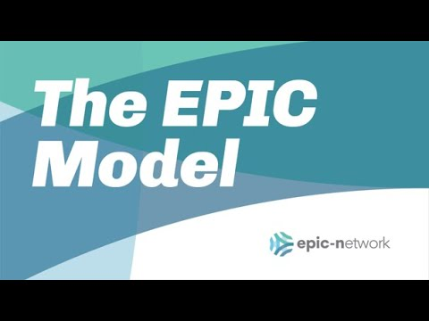
Notes:
Let’s dive into the EPIC Model…..the thing that allowed the Sage Project to unlock so much for the City of Lemon Grove....we’ll start with this quick animation.

Slide 11
The EPIC Question
What if we could connect existing university courses to a single city over an academic year to work on critical and vexing projects identified by city staff and do so at a scale that magnifies the value for all?
mcurry@epicn.org
608-709-8644
Notes:
Taking a step back. This is the question that really started our work from the beginning.
“READ THE QUESTION”
Our network has grown to this size from sharing this question and this model as an...idea.... We want to share it because of the larger scale impacts with communities we’ve seen it unlock in multiple different settings.
We know many of you are already doing community engagement work.
I like to think about Community Engagement practices like tools in a toolbox (you have your internship program in their, your campus as a living laboratory program, town-gown relationships, CSL)....We see the EPIC model as just another one of the tools we hope you’ll consider equipping yourself with.
Because with climate change, technology advances, and other social issues....We need all the tools we can get. With the EPIC MOdel You and your community partners can point all of your Community Engagement practices towards local issues, like sustainability, resilience, work force development, public health across disciplines all at once.
Now lets review the core elements of the model.....

Slide 12
The EPIC Model’s 5 Elements
Respects Existing administrative structures/individual responsibilities and incentives on all sides
A genuine Partnership
Intentionally aims at high-road development
Projects are Community-identified and -driven and evaluated on contribution to community
Multi-discipline and large Numbers (courses, students, hours)
mcurry@epicn.org
608-709-8644
Notes:
In general, all of our programs follow these 5 elements
“REAd ELEMENTS”
….Now lets dive a little deeper into what makes the model different....

Slide 13
How EPIC is Different
No new curricula
Community-identified projects
Scale adequate to problem
Multi-disciplinary
Opt-in by faculty
Programs manage logistics
Generally public sector partners
Fee-based, partner has “skin in the game”
mcurry@epicn.org
608-709-8644
Notes:
“Read slide to Program manager”
Public sector partners can mean cities, counties, special districts (like transit agencies), and they are regularly asked to bring in community leaders to support individual projects and those are regularly nonprofits and community groups dependent on the subject area.

Slide 14
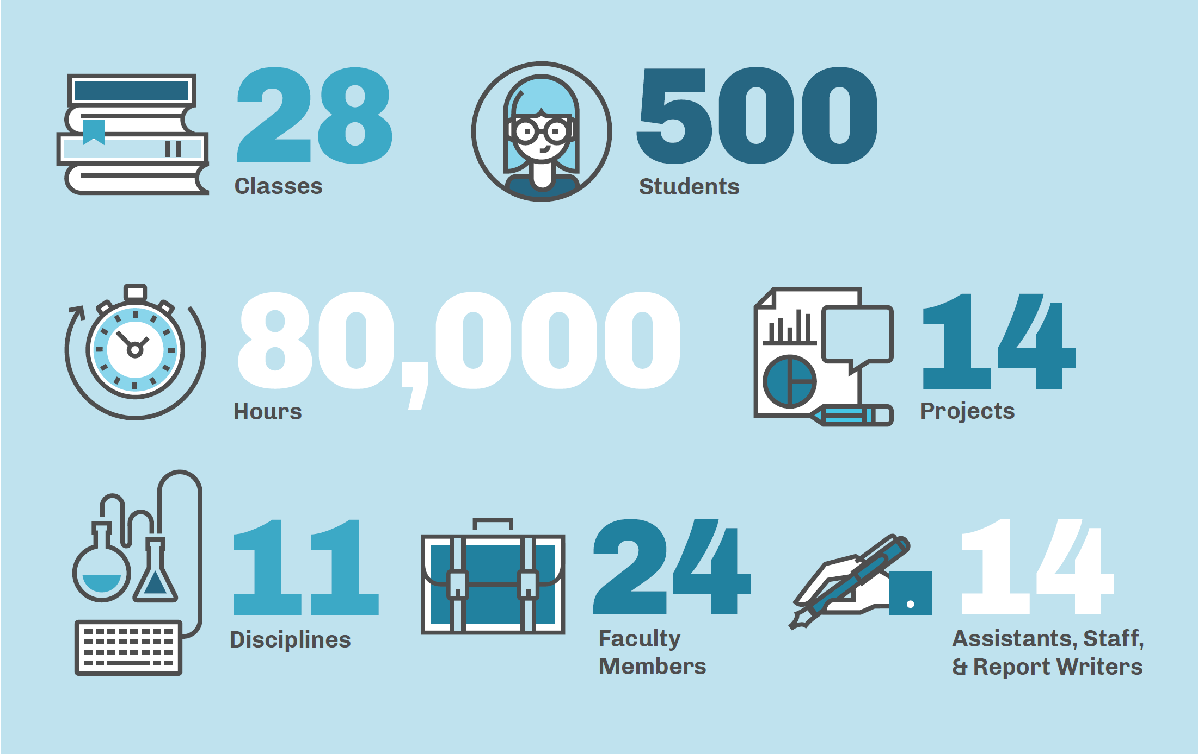
Notes:
To review….These are the kinds of university resources our partnership unlocks.
In one partnership year...the City of Salem accessed
“List the stats and pause before the 14 Staff”
Another crucial part of the EPIC Model is that student work gets reviewed and prepared before it is presented to community staff. In this case 14 student report writers were hired by the EPIC program to bring a consistency and quality to the work before it was handed to the project lead at the community…..

Slide 15
All based on
University resources
that already exist.
Notes:
A reminder, that all of the resources leveraged to complete these partnerships ALEADY Exist on campus.
….This asset based model has been recognized in the press...

Slide 16
“[EPIC is] perhaps the most comprehensive effort...to infuse sustainability into curricula and community outreach.”
— The New York Times
mcurry@epicn.org
608-709-8644
Notes:
….The New York Times recognized its ability to infuse sustainability into curricula….

Slide 17
“[EPIC is]... the easiest adopted and most efficient model I've seen for ensuring real and visible faculty and student contribution of value to area communities, while also improving the student learning experience"
— David Ward, past President of ACE and (2x) Chancellor of UW-Madison
mcurry@epicn.org
608-709-8644
Notes:
...University leaders like David Ward of ACE and UW-Madison identify at how efficient it is at ensuring real and visible faculty and student contribution of value to communities….

Slide 18
Sample Projects
Win – Win – Win
Notes:
We have over 1,000 individual projects recorded across our programs during their community partnerships. Here are a handful to show some of the diversity of disciplines and results.

Slide 19
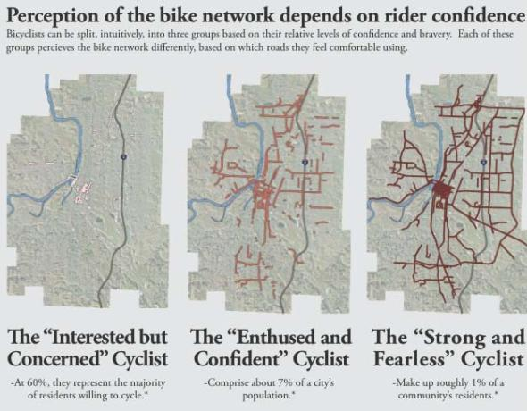
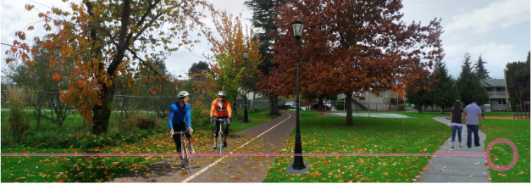
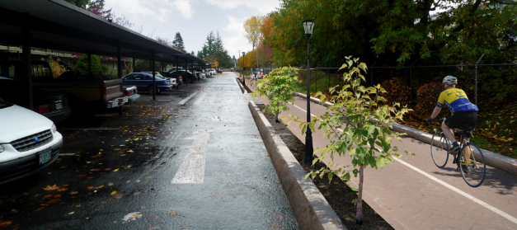

Improving Transportation Choices
Bicycle
Transportation
Marc Schlossberg
Planning
Last year in Redmond, 15 of 17 student ideas were adopted by policy within 6 months
Notes:
Projects can focus on transportation like this one in Oregon. Getting large number of students to pound the pavement lead to plans and realizations that the limited capacity of community staff time just can’t match…

Slide 20
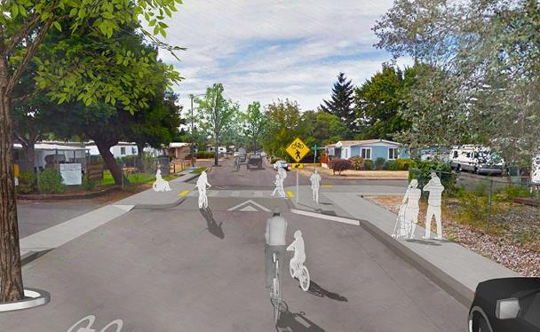
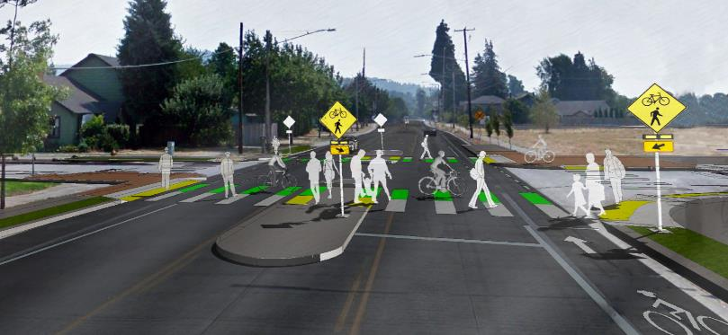
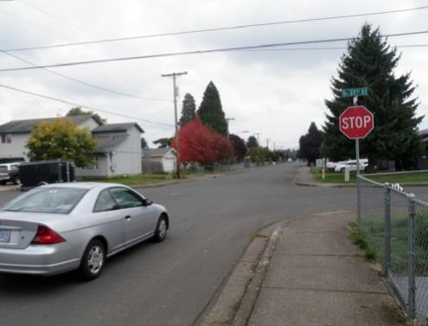
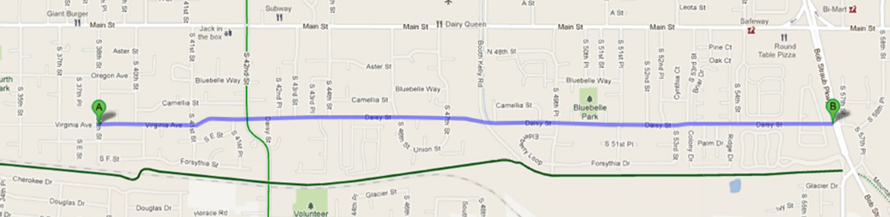
Improving Transportation Choices
Bicycle
Transportation
Pedestrian Safety
Traffic Calming
Generated: Community Support & Successful Grant Funding of 2018 Construction
Notes:
Results can often help planning and funding opportunities well into the future

Slide 21
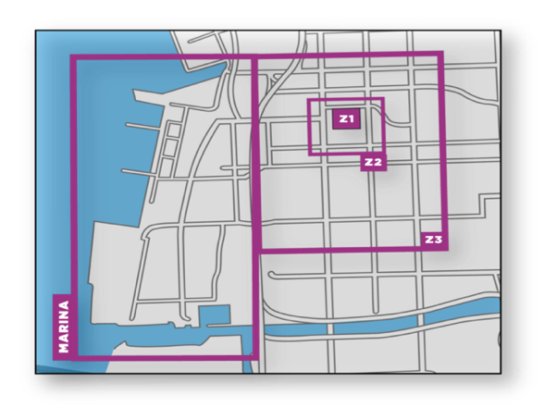
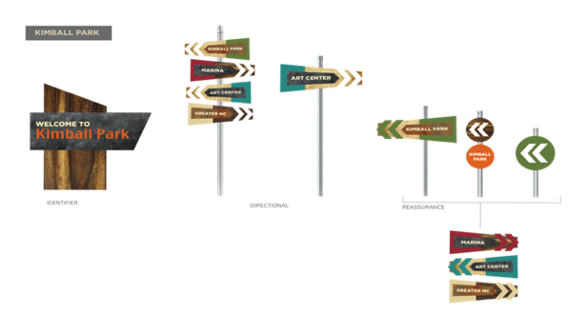
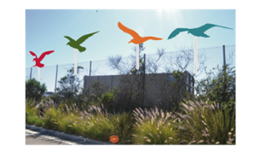
Economic Security and Sense of Place
Way-finding System
Patricia Cue Couttolenc Graphic Design
Resulted in over $1 million in wayfinding grants for National City, CA
Notes:
Students creativity help not only with designs for nice signs….in San Diego

Slide 22
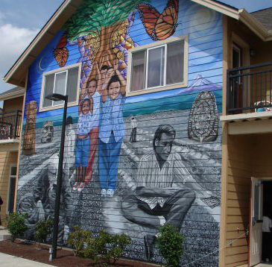
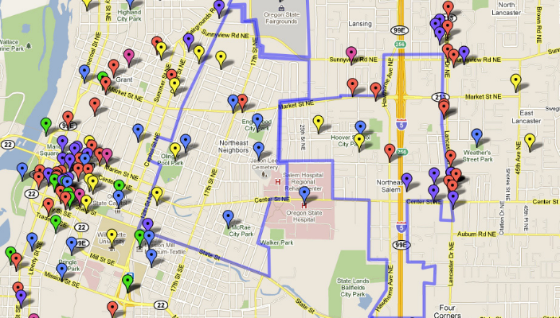
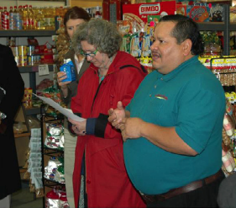
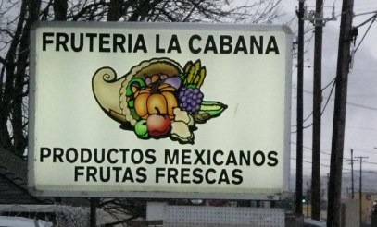
Engaging Marginalized Communities
Cultural
Mapping in
Northeast
Salem
Salem
Latino
Civic
Engagement
Gerardo
Sandoval
Planning
Doug Blandy and John Fehn Arts and Administration
Resulted in new participation on city boards, commissions, and elected office and better relationships with city officials.
Notes:
….they can help with complex and political issues. This project done near the regional food bank while I was a volunteer manager was and continues to be impactful. It is a great example of the vast disciplines that can be employed to meet community identified goals.

Slide 23
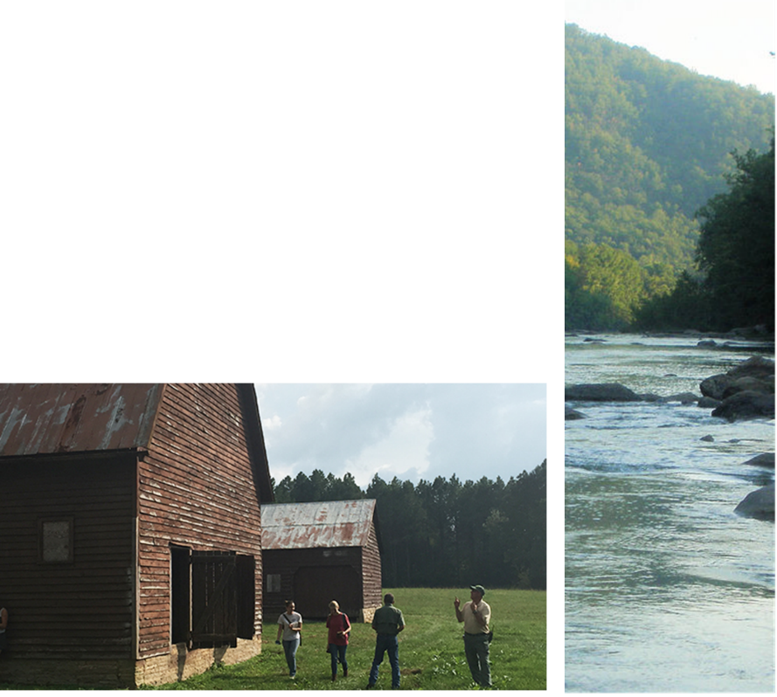

Watershed and Rural Health
Regional Water Quality Improvement Planning
Brad Collett Landscape Architecture
Notes:
We have projects focused on water management, rural programs...in Tennessee

Slide 24
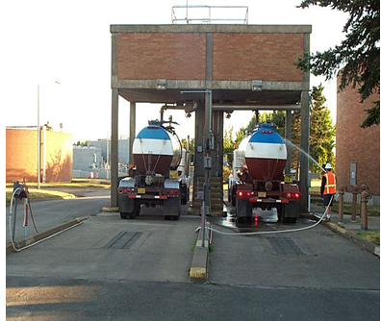
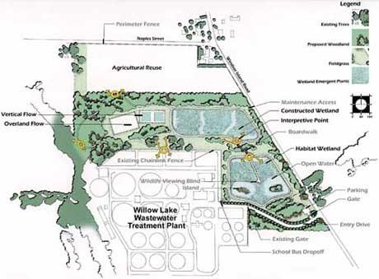
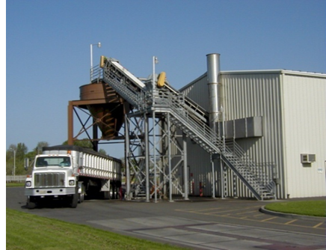

Economic Revitalization
Industrial By-Product Re-Use
Jennifer Howard-Grenville Business
Resulted savings first year and $3 Million incentive grant for
Now part of regional economic development strategy
Notes:
….economic revitalization and better use of waste streams

Slide 25
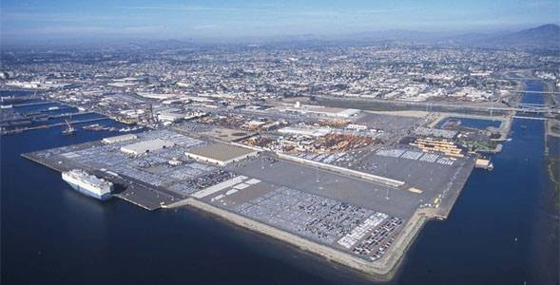
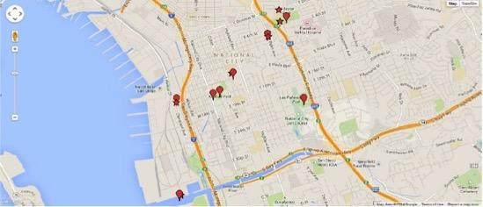
Air Quality and Urban Health
Freeway and Industry Impact and Mitigation
Zohir Chowdhury Public Health
Notes:
...public health…

Slide 26
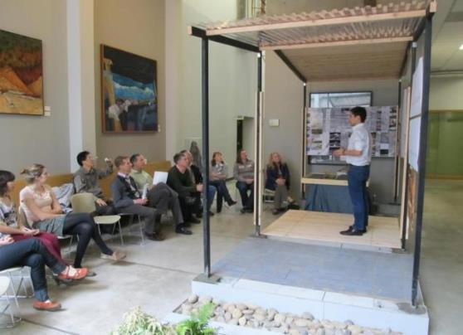
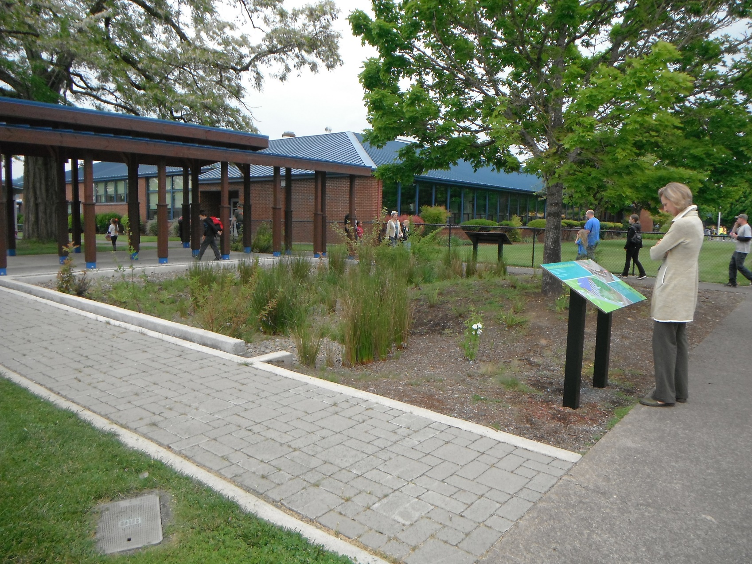
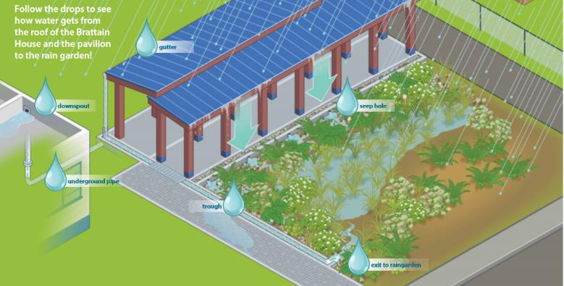
Rainwater Sites
Water
Management
Communicate
Design
Build
Educate
Notes:
….landscape architecutre….

Slide 27
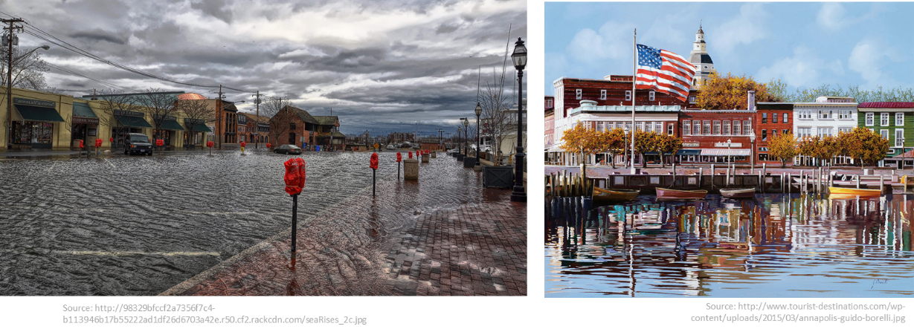

Sustaining Local Economies
Special Topics: Storm Surges & Sea Level Rise
Victoria Chanse Landscape Architecture
Notes:
…. And climate change in Maryland.

Slide 28

Why it works

Slide 29
Why EPIC Programs Work (for university)
Improves student learning experience
Improves student retention and later employment
Improves standing in community
Popular with alumni
mcurry@epicn.org
608-709-8644
Notes:
Anecdotally across our programs found that….For our University.
“READ”
We’ve found they improve...learning experiences
…retention and employment
...community standing
...engagement with alumni (many of our partners are alumni looking to engage faculty at their alma mater).

Slide 30
Why EPIC Programs Work (for the City)
City determines the projects
Simple administration
Clarity and accountability on work promised/delivered
Improves quality of city’s work
High value & ROI
mcurry@epicn.org
608-709-8644
Notes:
….For our “Cities”
They…
...determine the project
...enjoy less admin then current one-off projects to facilitate relationship
....like the simple clarity of one person and clearly defined agreements with each faculty/course. As well as the consistent and cleaner version for quality assurance with student work
….see improvement in morale and city work
….receive high value and, as noted before, higher ROI than expected.

Slide 31
Why EPIC Programs Work (for students)
Chance to apply new knowledge
To do so constructively, with expert supervision, toward good ends
Work experience and useful contacts
Course credit for doing so
mcurry@epicn.org
608-709-8644
Notes:
….For our “Students”
...They get to do REAL work
...They Apply knowledge
...They get to learn for good things. Not just the refrigerator
….They get to build their networks.
...They can do so without having a barrier to entry. This is so important for students who work, take care of family, etc. Especially as we all look to better support ALL of our students and their needs differently classes are where many of our resources to meet students where they are at, already exists….Now They get to use the class work they already prioritize beyond CSL, weekend volunteering, etc

Slide 32
Why EPIC Programs Work (for faculty)
Voluntary
Tests ideas
New contacts and experience
Teach the same course with less administration and more resources
mcurry@epicn.org
608-709-8644
Notes:
….For Faculy
...It is voluntary. No arm turning
…They get to test ideas in real life
….build their network too
…....They get to teach the same course, just point the case study and with a lower barrier to entry….You probably have faculty doing this work already, but doing all of their own administration, partner recruitment, logistic work themselves or with their department support staff. Our model suggest identifying one program manage to help with all of this to make it easier for community and faculty. We’ve found faculty who are intimidated by community engagement work will join our EPIC programs..

Slide 33
How it works
Notes:
Pause here. Check for time. If necessary, skip and then move on to how to learn more. Otherwise read through slides.

Slide 34
Linking Knowledge to Practice
Cities
Universities
Lack capacity
Lack access to new knowledge
Risk averse
Excess capacity
Unlimited access to new knowledge
Innovation seeking
Notes:
In general we’ve found these programs work by matching city needs with university assets

Slide 35
Project Match-Making
Generated by both city and university
Iterative
Consider sequential and concurrent courses
Consider different levels of similar discipline
‘Pound the pavement’ / ‘Knock on doors’
Program manager as university/community coordinator
mcurry@epicn.org
608-709-8644
Notes:
The program manager and the project lead do intensive project match-making and this is what I really see as intriguing and brilliant about the model. During this deep relationship building, the program manager, partner lead, and faculty get to spend extra time aligning the catalogue of courses available to the community to make some iterative./.Sequential….scaffolding to meet the community's needs….
For example, the community might want a new park design and an engagement strategy get community input on the design. So the team might have undergrad sociology class in the first semester…..with students going to community events and writing up findings then hand those over to a graduate level landscape architecture course the next semester to do some preliminary designs of the park to help the community continue the dialogue, and get one step closer to being able to go to a contractor to find a final design and build the new park.

Slide 36
Project ‘Scope of Work’
Created by city and university project leaders
Purpose of project/desired outcomes
Responsibilities
Stakeholders
Timelines
Budget
mcurry@epicn.org
608-709-8644
Notes:
During the scoping process the program manager and the partner lead will come to agreement on the following subjects.

Slide 37
Recipe for success
Buy-in from city manager’s office and above
Communication between city staff and council
Understanding of city’s needs and students’ capacity to deliver
City must have ‘skin in the game’
University support is key
mcurry@epicn.org
608-709-8644
Notes:
To be successful we’ve found the EPIC Model partnerships really do well with the following.

Slide 38
Get Connected
Visit our website
www.epicn.org
Sign up for our mailing list
www.epicn.org/contact/
Email us
info@epicn.org for specific information and guidance
Follow us!
Twitter @EPICNtweet,
Facebook @epicn.org
LinkedIn
Notes:
If you want to learn more about us and get connected. Please
Visit our website
Sign up for our mailing list

Slide 39
Join the EPIC Network
Sign up!
Receive free resources to help you ‘Just Start’ your EPIC-N program: https://goo.gl/S4wBgt
Contact some of our EPIC-Network programs:
Visit www.epicn.org/whos-in-the-network to view other programs, their stories, and their community impact.
Learn more about Membership:
Visit portal.epicn.org to learn about the resources we provide members programs.

Slide 40
EPIC-N Speakers
Marshall Curry
Program Associate
mcurry@epicn.org
608-709-8644
@marshall_curry
Joel Rogers
Chair, Treasurer/Secretary
jrogers@epicn.org
608.890.2543

Slide 41
Exciting and Effective Community – Higher Education Collaborations
Marshall Curry and Joel Rogers
Notes:
Thanks Debra and Daita for that kind introduction.
------->

